Slide 1
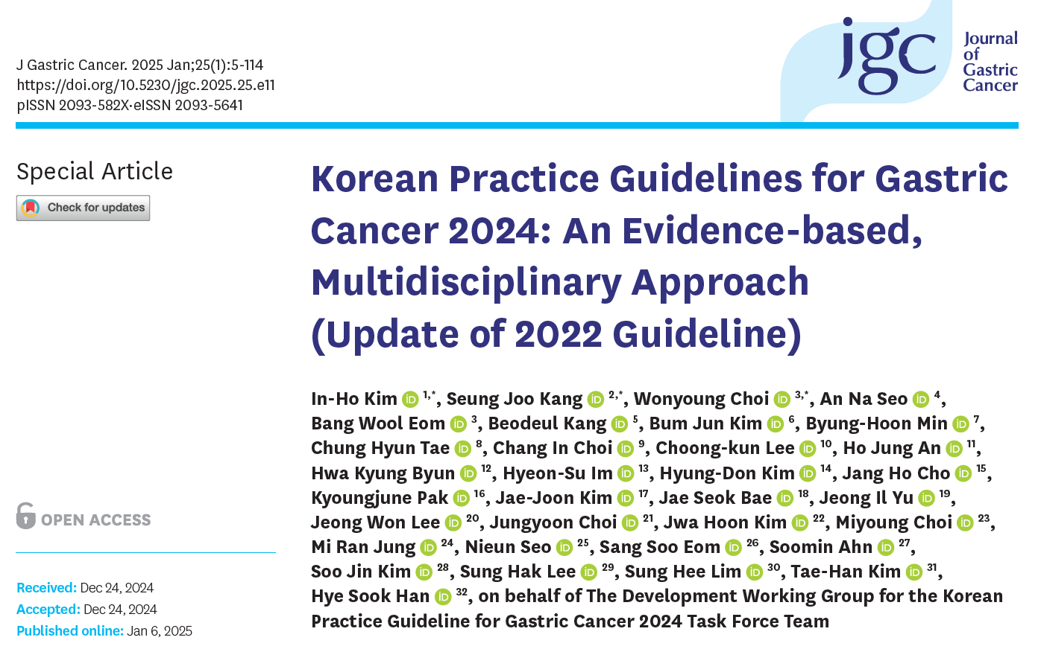
Kim. J Gastric Cancer 2025;25:5-114

Slide 2
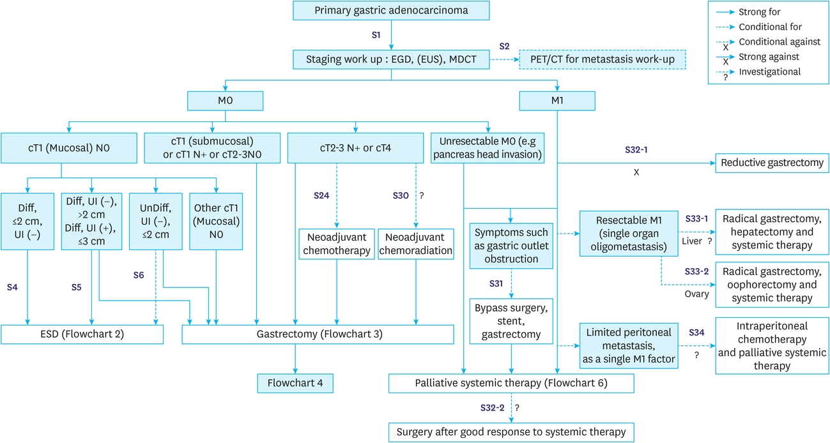
Overall treatment (KGCA 2024 guideline)
Kim. J Gastric Cancer 2025;25:5-114
Notes:
This is the overall treatment algorithm in the recent Korean guideline. Regarding the staging, EUS and PET/CT are mentioned as optional modalities.

Slide 3
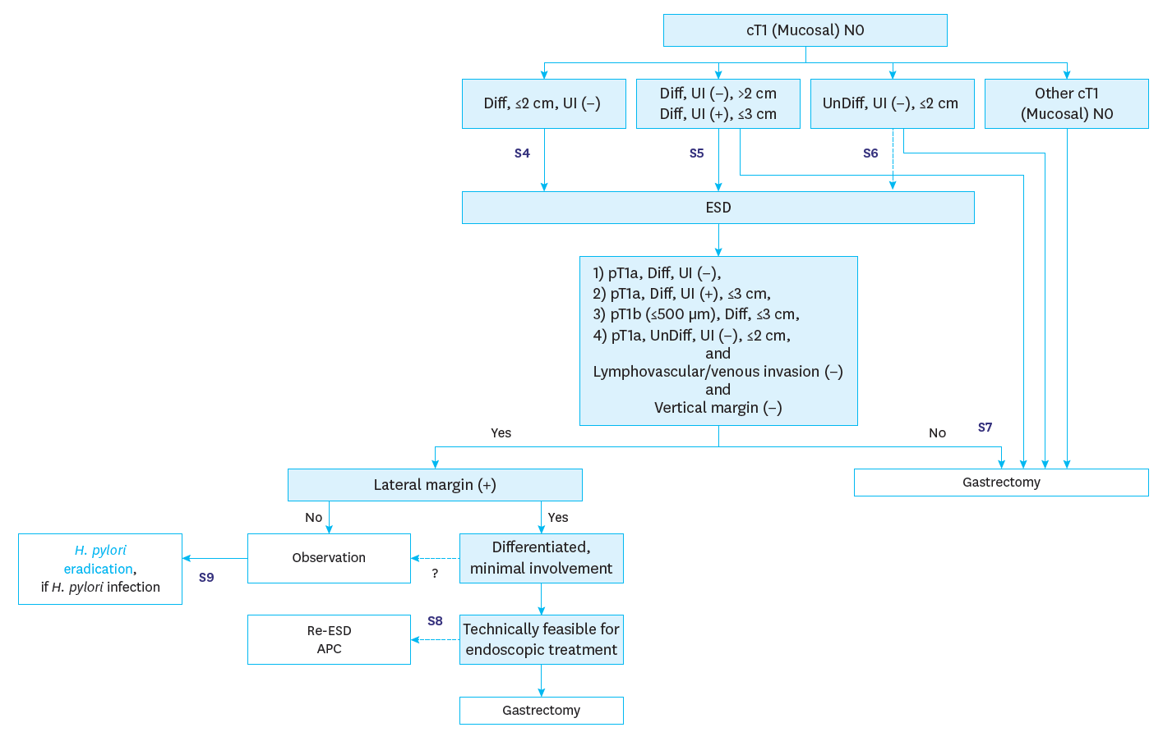
Flowchart 2 (ESD)
Kim. J Gastric Cancer 2025;25:5-114

Slide 4
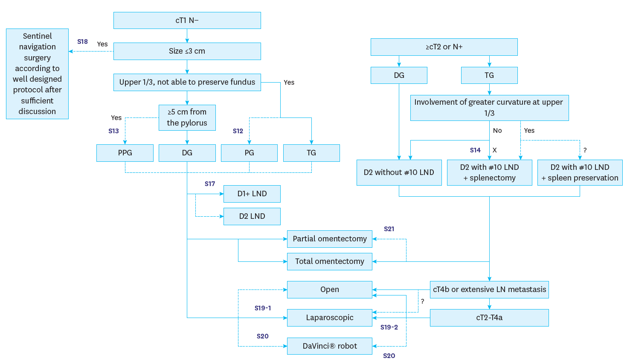
Flowchart 3 (surgery)
Kim. J Gastric Cancer 2025;25:5-114

Slide 5
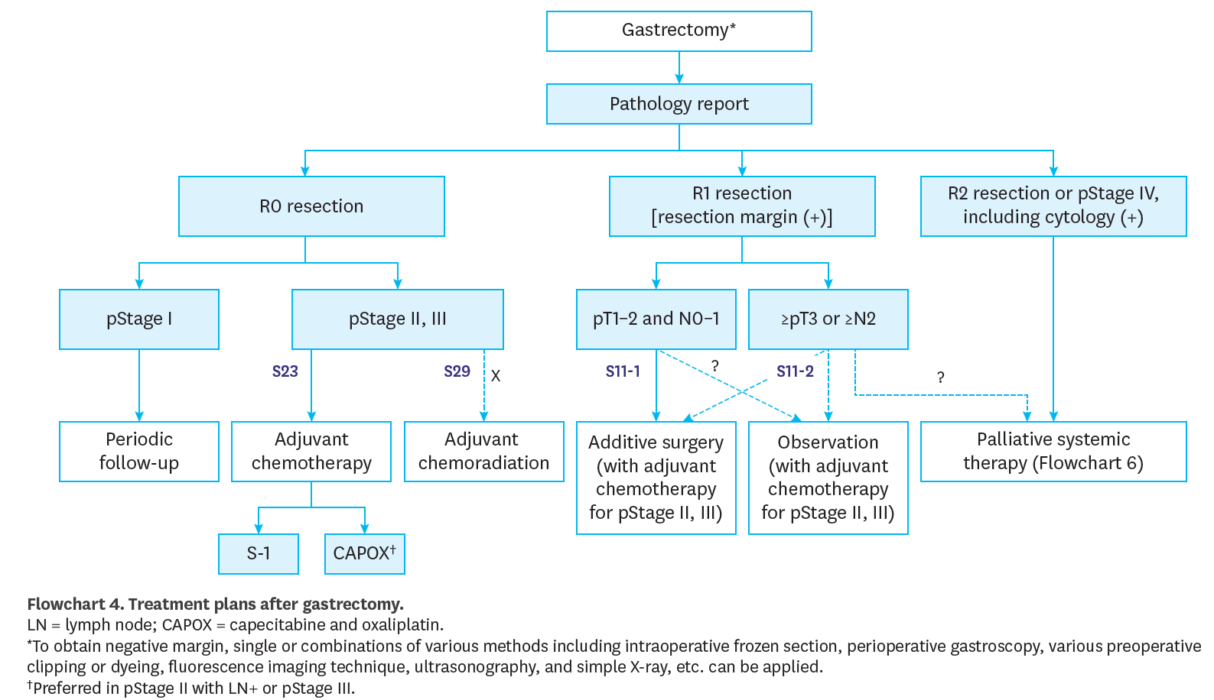
Flowchart 4 (after surgery)
Kim. J Gastric Cancer 2025;25:5-114

Slide 6
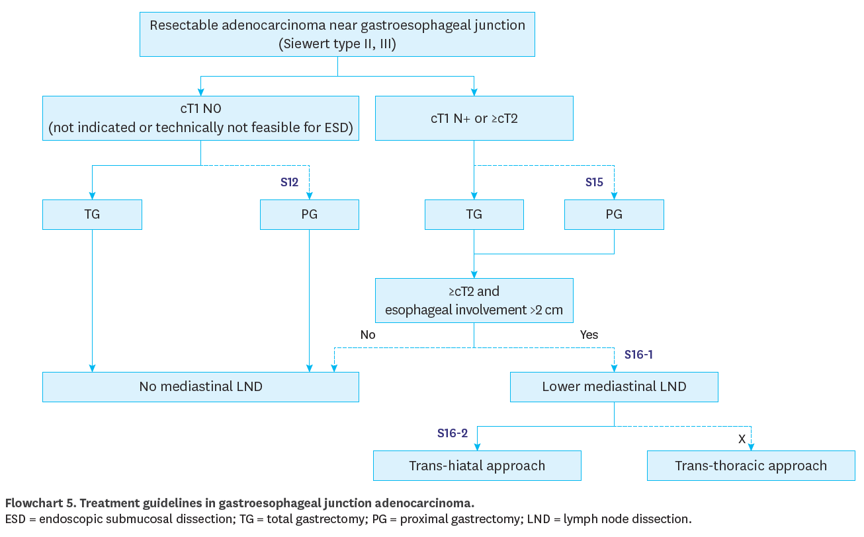
Flowchart 5 (GEJ cancer)
Kim. J Gastric Cancer 2025;25:5-114

Slide 7
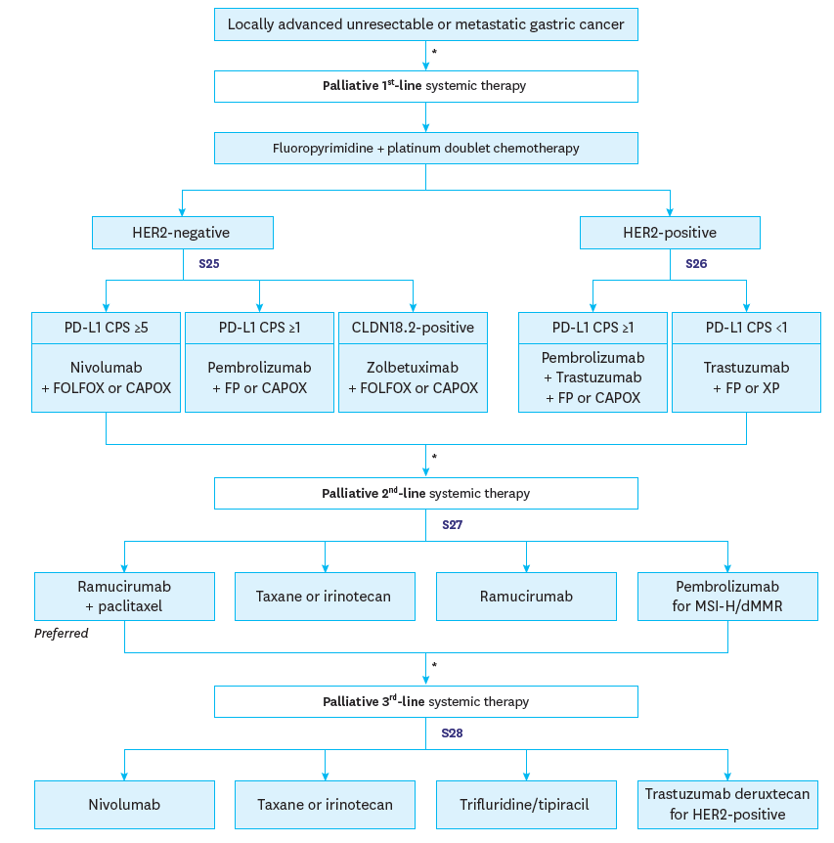
Flowchart 6
(palliative)
Kim. J Gastric Cancer 2025;25:5-114

